Slide 1
BitGC for Efficient Rate-One 2PC
Hanlin Liu, Xiao Wang, Kang Yang, and Yu Yu

Slide 2
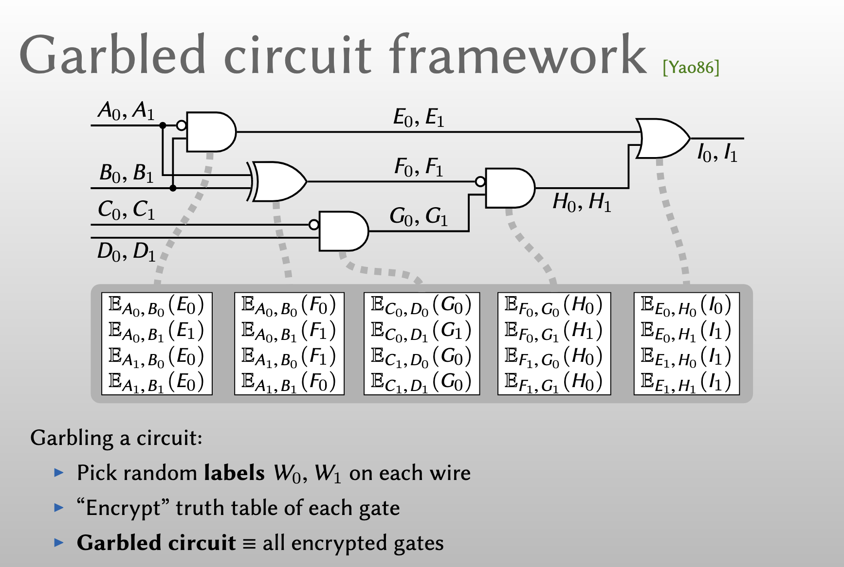
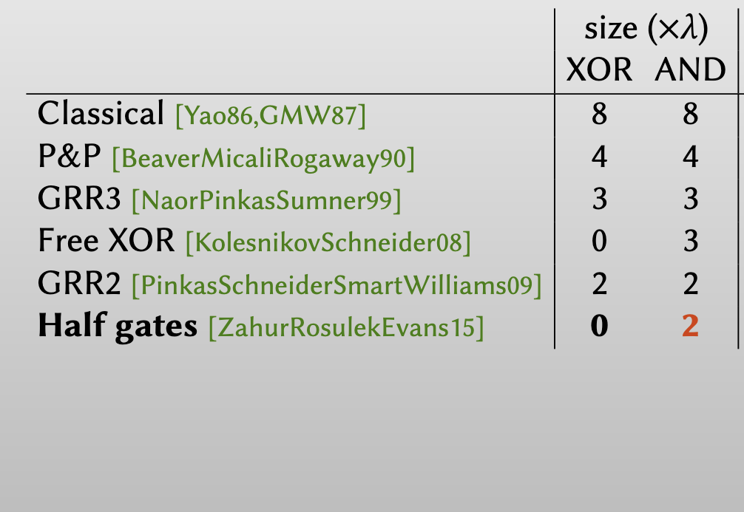
O(κ) seems unavoidable in MiniCrypt!!
Three-halves [RosulekRoy21] 0 1.5

Slide 3
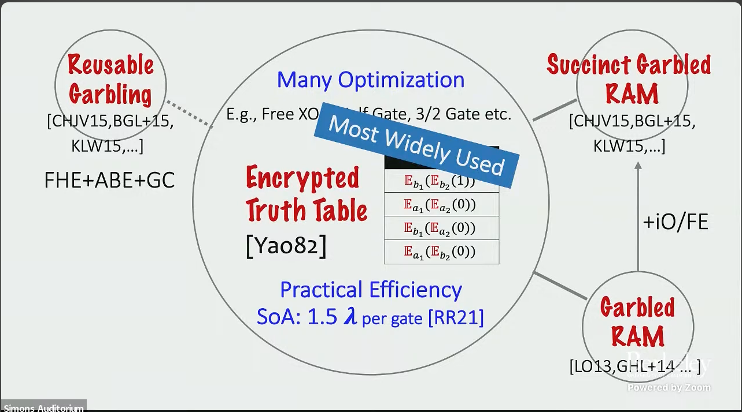
Is there anything in the middle?
Computation: >> FHE
Communication: << 200 bits per gate

Slide 4
Our Results
A garbling scheme of size 1 bit per gate
  Based on circular-secure Ring-LWE
  No bootstrapping at all

Slide 5
Why Classical Garbled Circuit is So Big?
AND
Garbler
Evaluator
Encryptions of C’s under (A,B)’s
Needs to contain information of C

Slide 6
A Different Way to Think About GC
AND
[]: secret sharing
Garbler
Evaluator
Encryptions of output shares under input shares
Only needs to contain information of v_{a}, v_{b}

Slide 7
“Blueprint”
AND
Garbler
Evaluator
Encrypted truth table bits
Garbler cannot obtain it non-interactively
[[ ]]: encryption
Our solution: distributively evaluate encrypted truth table directly

Slide 8
Some Technical Details!

Slide 9
AND
Garbler
Evaluator
1
0

Slide 10
=0
Assuming RO is homomorphic:
Encrypted Truth Table Bits

Slide 11
Garbler
Evaluator
Define
Our solution: distributively evaluate encrypted truth table directly

Slide 12
So Far…
If only there is a way to send ciphertext cheaply
and a way to instantiate homomorphic RO !
Garbler
Evaluator

Slide 13
More Technical Details Now!

Slide 14
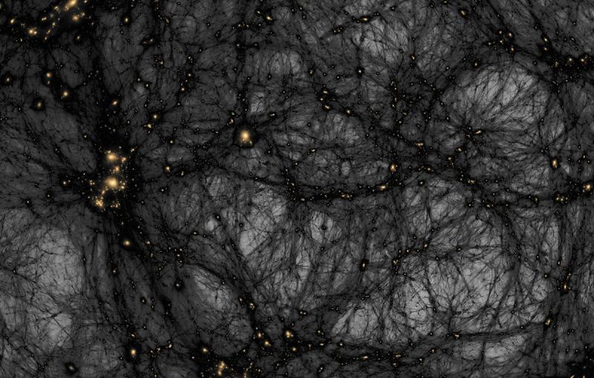
Transmitting Encrypted Bits is Cheap
To send an encryption of bit x
Bitstring labels not compatible with SWHE!
[[seed]]
[[r1]]
[[r1]]
…
=PRG( )
…
=PRG( )
[[seed]]
[[seed]]
[[rn]]
[[rn]]
d = x ⊕ ri
[[x]]
= ⊕ d
[[ri]]
Need a PRG that we can evaluate in HE without bootstrapping
[TCC:BIPSW18,…]

Slide 15

Using Polynomial Rings as Wire Labels
Garbling based on bit-strings
Garbling based on ring elements

Slide 16
Garbler
Evaluator
Define
Can we find such an Eval ??

Slide 17
Instantiating Homomorphic RO
Distributed “Evaluation”:
Assume
Homomorphic RO:

Slide 18
Garbler
Evaluator
Define
Compute

Slide 19
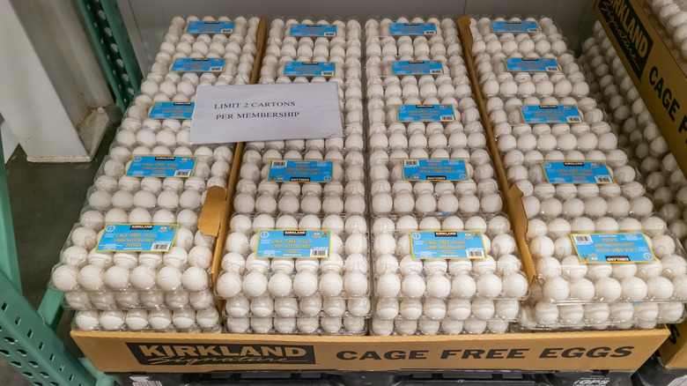
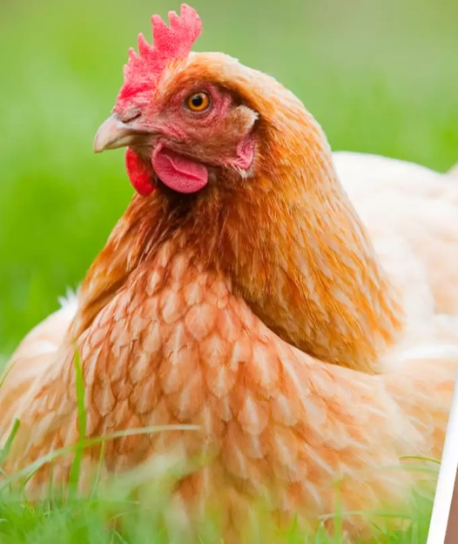
Wait a Second!

Slide 20
Avoiding Chicken-N-Egg

Slide 21
Avoiding Chicken-N-Egg
Case 1:
Case 2:
Eval is an odd function
Output space of Eval is even

Slide 22
Recap
Garbler
Evaluator

Slide 23
Properties that we need
Encrypted truth table bits
Homomorphic evaluation of a PRG and 2 more levels to assemble
Use GSW
OR
assume circularity and send an encryption of Δ

Slide 25
Near Linear Decryption [BoyleKohlScholl19]
Plaintext space
Noise budget
Requirement:
Gap to allow lifting lemma “mod p can be dropped”
Gap to allow rounding lemma
“round can be added over q”

Slide 27
Garbler
Evaluator

Slide 28
Garbler
Evaluator

Slide 29
Cost
Garbler
Evaluator
Most cost in generating

Slide 30
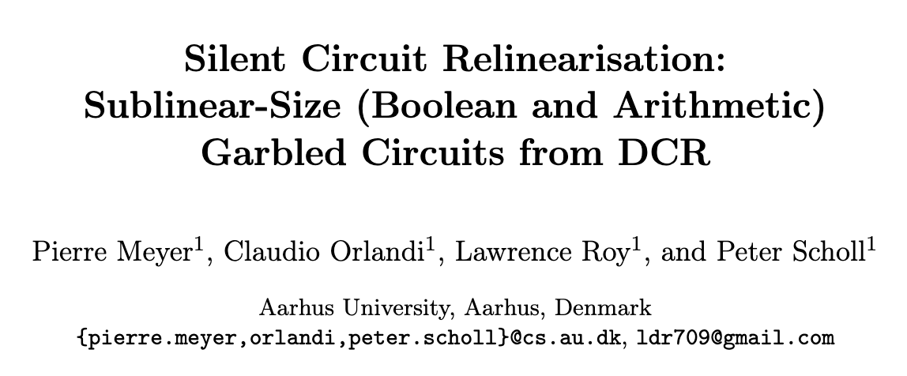
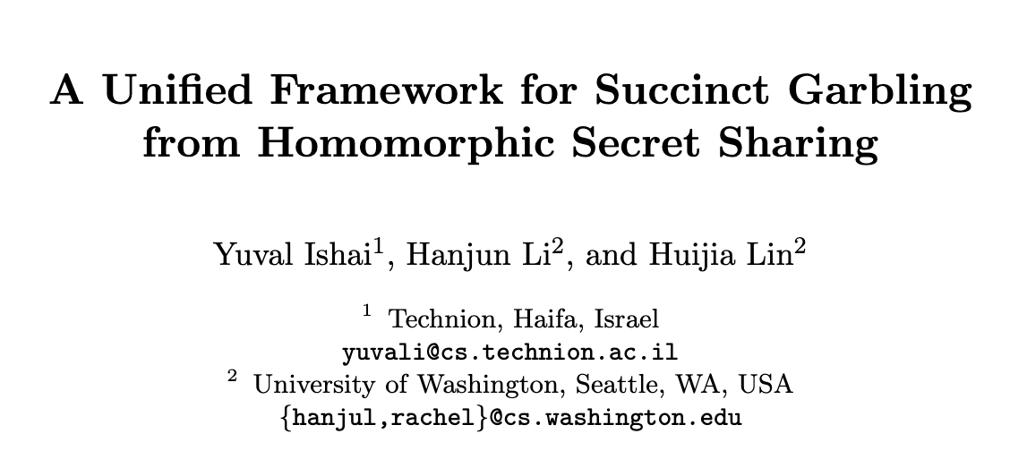
Open Questions
ePrint:2025/245
Free-XOR?
Garbled RAM?
Sublinear-size? How sublinear?
ePrint:2025/442

