Slide 1
BitGC: Garbling with 1 Bit per Gate
Xiao Wang

Slide 2
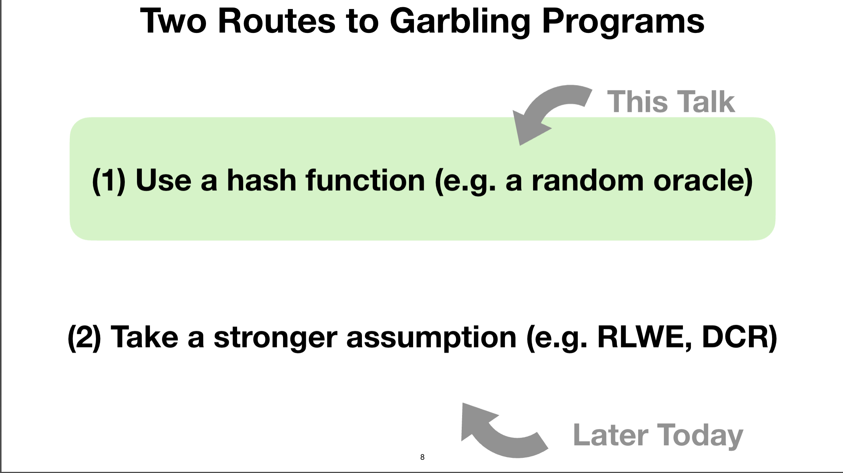
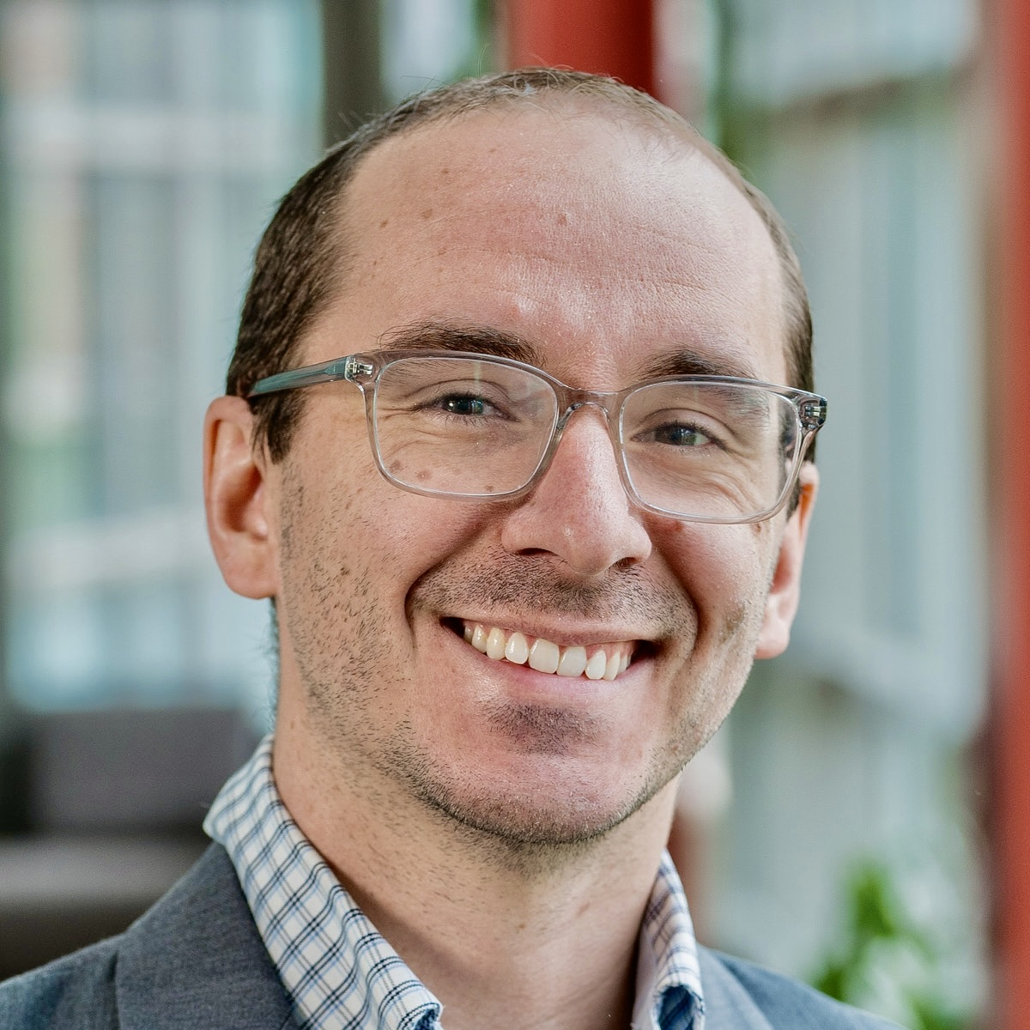
1.5κ is unavoidable in MiniCrypt!!
“Lower Bounds for Garbled Circuits from Shannon-Type Information Inequalities”, Januzelli, Rosulek, Roy. CRYPTO25

Slide 3
Outline
BitGC: A garbling scheme of size 1 bit per Boolean gate
  Hanlin Liu, Xiao Wang, Kang Yang, Yu Yu
  Circular-secure Ring LWE
  Appeared in Eurocrypt 2025
Ongoing progress in pushing BitGC’s concrete efficiency
  LWYY + Wenhao Zhang, Wenjie Lu, and Chenkai Weng
  10 ms per gate for single-thread CPU (with some caveat)

Slide 4
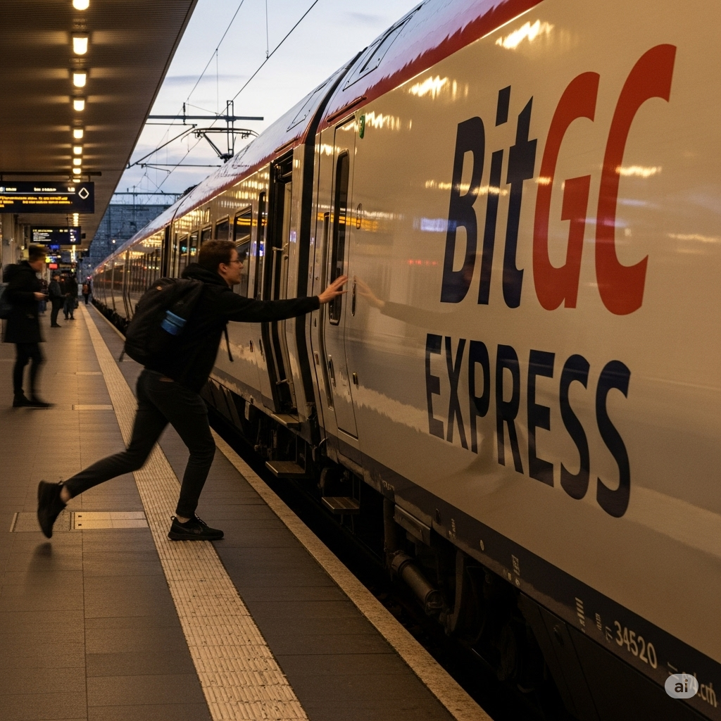
Related Work
To appear Crypto 2025
  “Authenticated BitGC for Actively Secure Rate-One 2PC” by Liu, Wang, Yang, Yu
  “A Unified Framework for Succinct Garbling from Homomorphic Secret Sharing” by Ishai, Li, Lin
  “Silent Circuit Relinearisation: Sublinear-Size (Boolean and Arithmetic) Garbled Circuits from DCR” by Meyer, Orlandi, Roy, Scholl
To appear FOCS 2025
  “Succinct Homomorphic MACs from Groups and Applications” by Ishai, Li, Lin,

Slide 5
Why Classical Garbled Circuit is So Big?
AND
Garbler
Evaluator
Encryptions of C’s under (A,B)’s
Needs to contain information of C

Slide 6
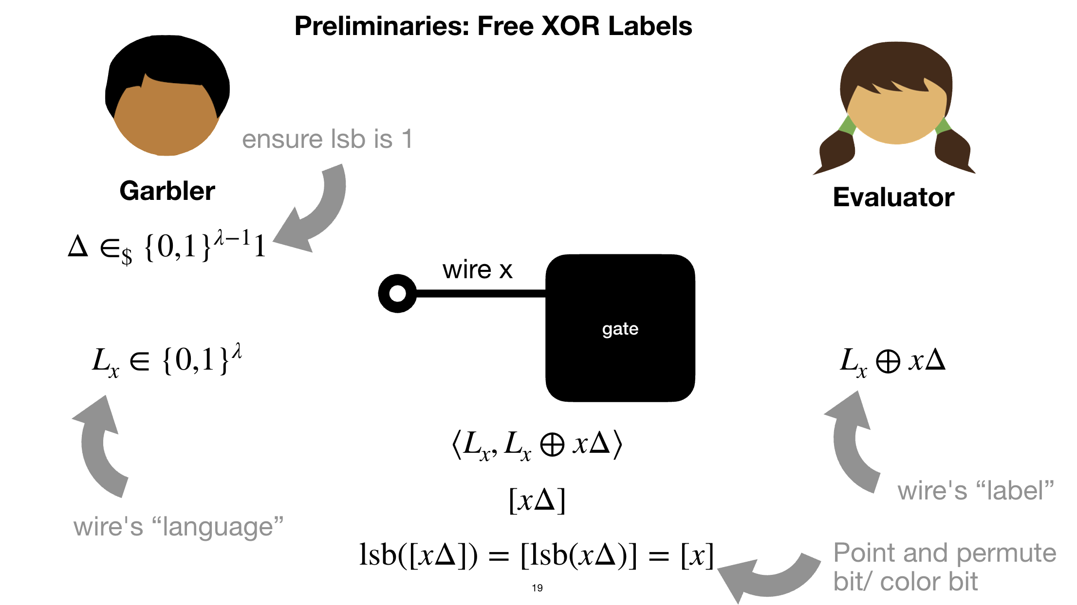
A Different Way to Think About GC
AND
[]: secret sharing
Garbler
Evaluator
Encryptions of output shares under input shares
Only needs to contain information of v_{a}, v_{b}

Slide 7
“Blueprint”
AND
Garbler
Evaluator
Encrypted truth table bits
Garbler cannot obtain it non-interactively
[[ ]]: encryption
Our solution: distributively evaluate encrypted truth table directly

Slide 8
Some Technical Details!

Slide 9
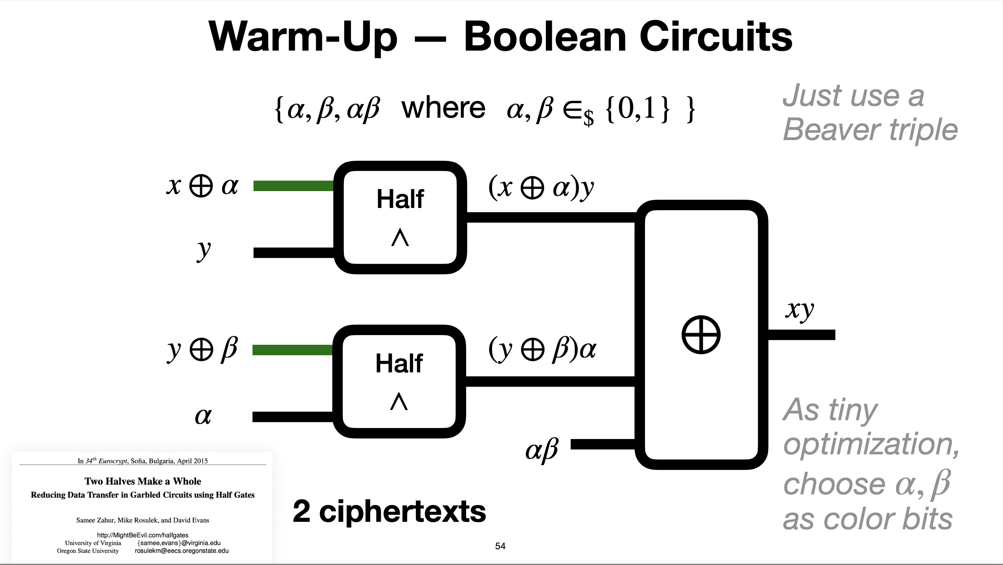
AND
Garbler
Evaluator
Gate index omitted throughout the talk!

Slide 10
=0
Assuming RO is homomorphic:
Encrypted Truth Table Bits

Slide 11
So Far…
If only there is a way to send ciphertext cheaply
and a way to instantiate homomorphic RO !
Garbler
Evaluator
Evaluate to obtain

Slide 12

Transmitting Encrypted Bits is Cheap
To send an encryption of bit x
Bitstring labels not compatible with SWHE ciphertext!
[[seed]]
[[r₁]]
[[r₁]]
…
=PRG( )
…
=PRG( )
[[seed]]
[[seed]]
[[r_{n}]]
[[r_{n}]]
d = x ⊕ r_{i}
[[x]]
= ⊕ d
[[ri]]
Need a PRG that we can evaluate in HE without bootstrapping
[TCC:BIPSW18,…]

Slide 13

Using Polynomial Rings as Wire Labels
Garbling based on bit-strings
Garbling based on ring elements

Slide 14
Garbler
Evaluator
If only there is a way to send ciphertext cheaply
and a way to instantiate homomorphic RO !

Slide 15
Instantiating Homomorphic RO
Distributed “Evaluation”:
Assume
Homomorphic RO:

Slide 16
Garbler
Evaluator
Define

Slide 17
Recap
Garbler
Evaluator
Compute

Slide 18
Properties that we need
Encrypted truth table bits
Homomorphic evaluation of a PRG and 2 more levels to assemble
GSW
OR
Any regev-like scheme + send an encryption of Δ, invoking circularity

Slide 20
Near Linear Decryption [BoyleKohlScholl19]
Plaintext space
Noise budget
Requirement:
Gap to allow lifting lemma “mod p can be dropped”
Gap to allow rounding lemma
“round can be added over q”

Slide 22
Garbler
Evaluator
a.k.a. “succinct homomorphic MACs” [ILL24],
“semi-private HSS” [MORS25]

Slide 23
Garbler
Evaluator

Slide 24
BitGC (Being) Made Concretely Efficient
Offline homomorphic PRG expansion:
  ↑ Depth-5 BGV
  ↑ SIMD-accelerated evaluation
  ↓ Ciphertext unpacking to RLWE ciphertext
Gate assembling:
  ↑ 6 ring multiplications per gate
  ↑ ️ Additive homomorphism sufficient to assemble the gate
  ↓ Increase size of AND to 6 bits and XOR to 2 bits

Slide 25
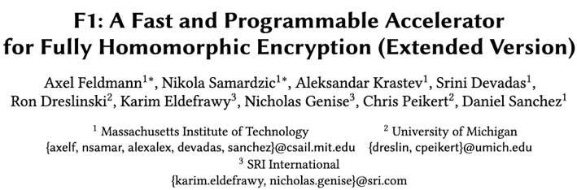
BitGC (Being) Made Concretely Efficient
CPU, single-thread
Offline preprocessing: 1 – 7 ms per gate
Garbling: 3 ms per gate
FPGA (estimated)
Offline preprocessing: 0.1 – 0.4 us per gate
Garbling: 0.2 us per gate
FHE and garbling are for different purposes but speed comparable to TFHE evaluation.

Slide 26
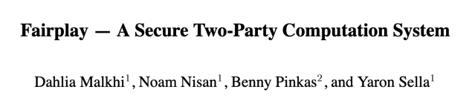
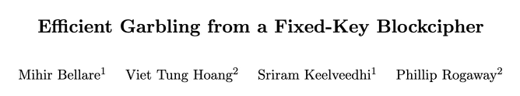
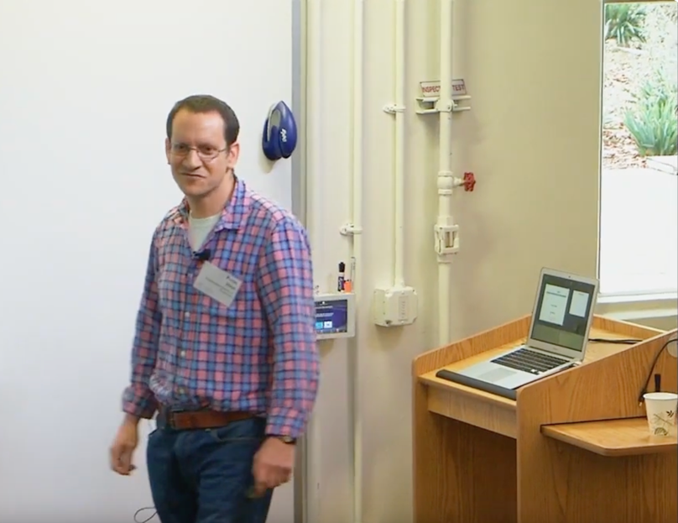
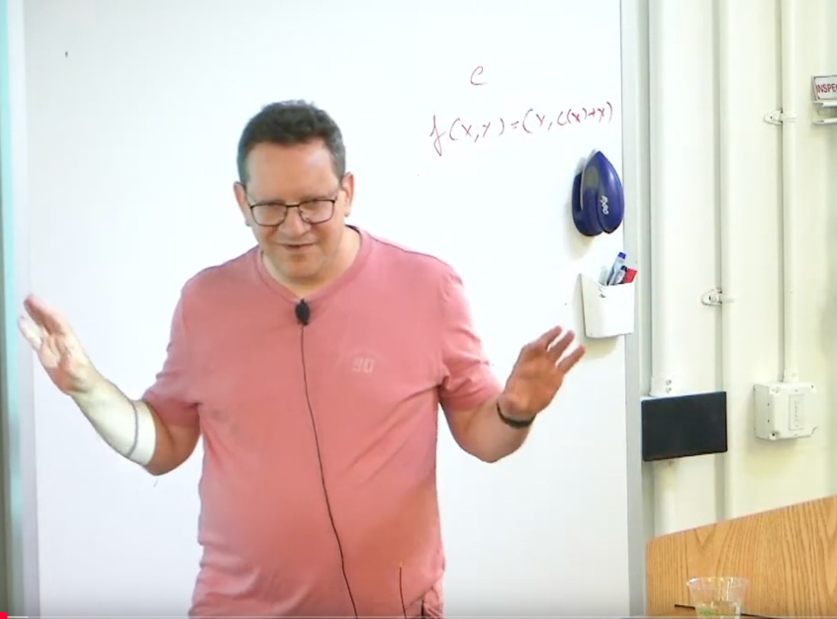
What 10 years can do?
~0.1 s/gate USENIX 2004
~100 ns/gate SP 2013
Cryptography 10 Years Later
Cryptography Boot Camp 2015
BitGCrazy 2035
?? s/gate
BitGC 2025
0.01 s/gate

